Slide 1


HOME CREDIT DEFAULT RISK
PROJECT PROPOSAL FIRST PRESENTATION
HONG WEI KOH & SIVA KRISHNA THOTA

Slide 2
Agenda
Business problem
Approach
Data / Data wrangling
Exploratory data analysis
Predictive modeling
Conclusion
Future work

Slide 3
Business Problem
Many people struggle to get loans due to insufficient or
non-existent credit histories
This population is often taken advantage by untrustworthy lenders.
Home credit tries to include the unbanked population to support their
economic needs.

Slide 4
Goal
Identify if a new client shows a high risk for loan default
How can this help?
Reduce Uncertainty
Proportional Disbursement
Risk Reduction

Slide 5
Data Set
The Data is taken from Kaggle’s competition publicly available
application_train.csv
307511 Records, 122 Columns
Imbalanced Target Labels.
Source for training machine
Learning models.
Target Labels :
0’s – 282686, 1’s - 24825
application_test.csv
48744 Records, 121 Columns
No Target Labels.
Source for testing the performance of machine Learning models.
Target Labels :
None – need to predict.

Slide 6
Understanding Data Set
There are 122 columns with different data types:
65 floating point numbers.
41 integer numbers – some are numerical categories.
16 Strings – Categories involved

Slide 7
Data Clean
Cleaning steps can be many, relative to the approach taken & judgement calls.
Since the ML model can’t inherently deal with text, the data must be converted to appropriate numbers. Any significant distortion/noise in the model must be removed as much as possible.
Converting string categorical columns into numerical – Label encoding.
Converting string categorical columns into numerical and adding new columns to indicate the presence of categorical variables – One hot encoding.
Replacing illogical outliers with empty values (NAN values).
Imputing empty cells with the median of the values. In some cases, imputation is approached with a certain grouping.
Dealing with a few anomalies.
Changing invalid entries into valid entries.

Slide 8
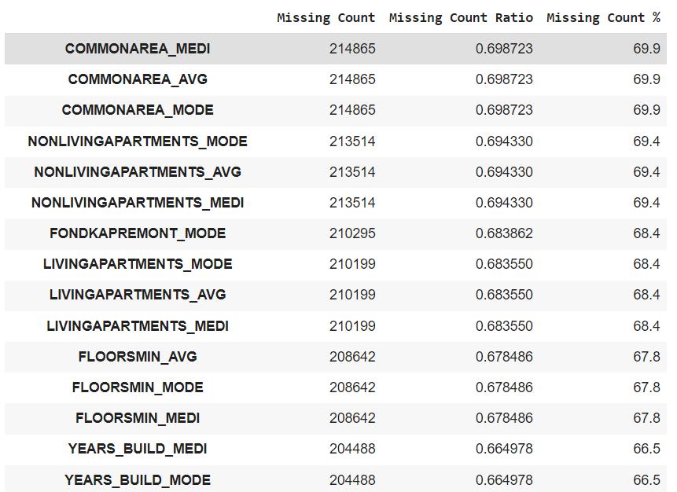
Train Data Set Top 15 Columns with Missing values

Slide 9
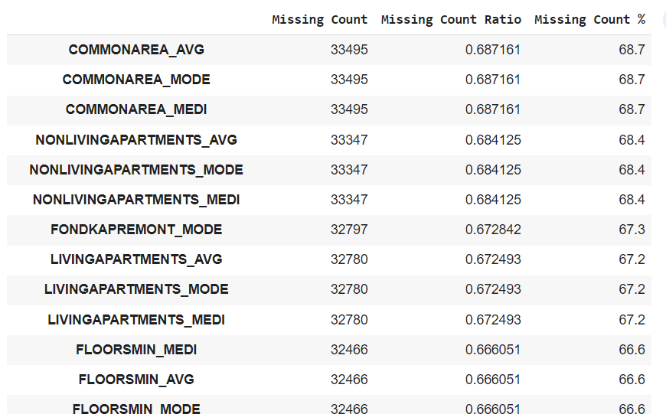
Test Data Set Top 15 Columns with Missing values

Slide 10
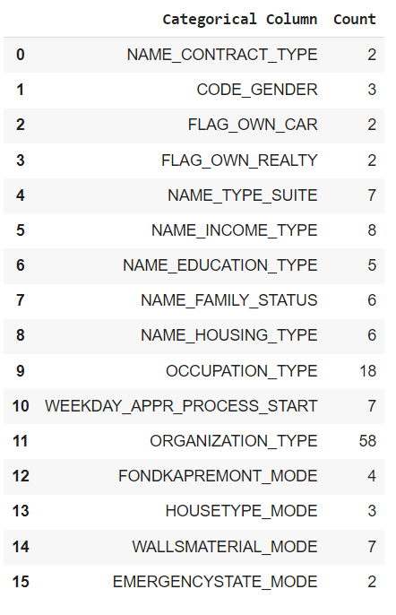
Different kinds of classes in every categorical column

Slide 11
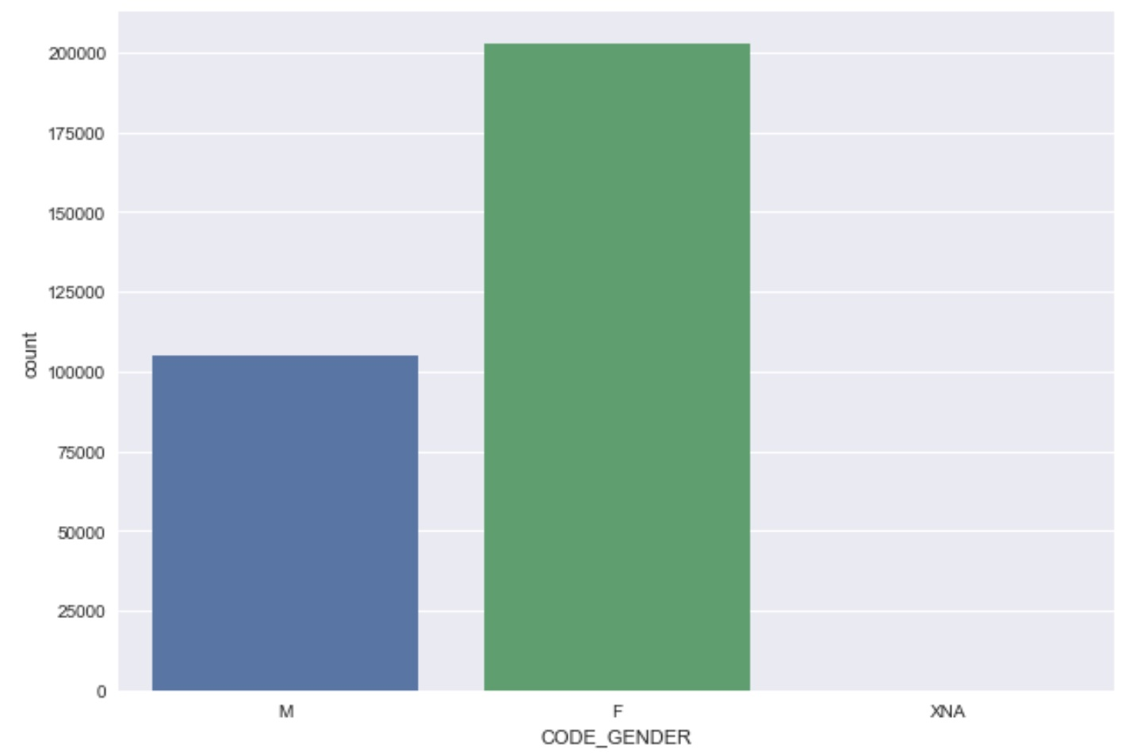
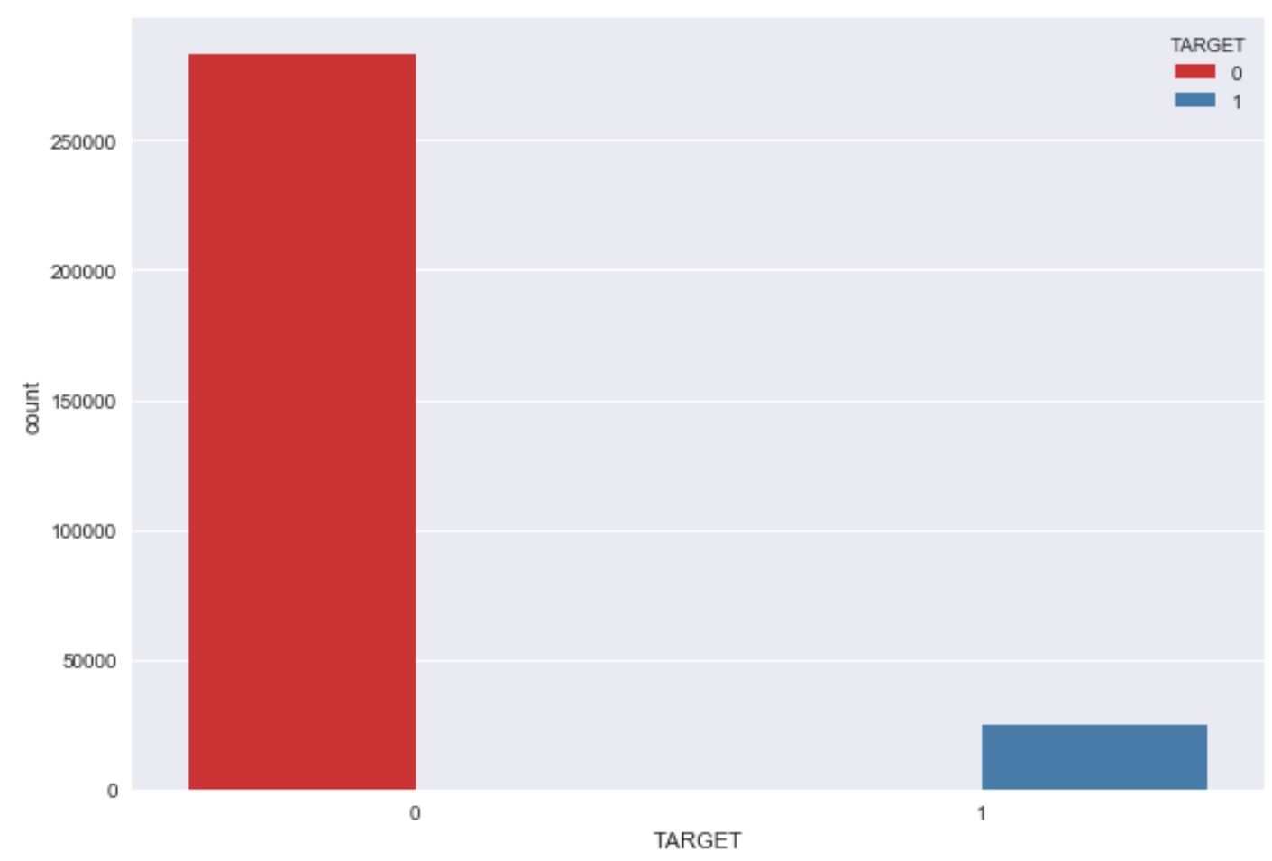
Target Column
EDA suggests that most people returned the money
Females are the highest borrowers with counts:
F - 202448
M - 105059
XNA - 4
Most people returned the borrowed money:
0 - 282686
1 - 24825

Slide 12
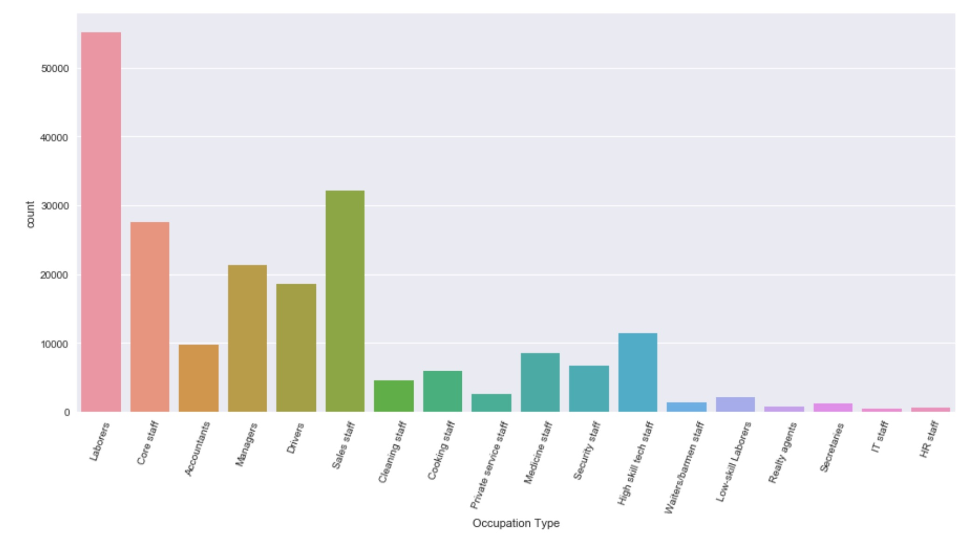
Occupation type vs Borrowers
Laborers - occupation type were the most borrowers.
Most of the clients are laborers and the least of the clients are IT Staff.

Slide 13
ML Models
Predictive Modeling – Outcome of the model is expected to identify the potential that someone will default on a loan
ML Model :
PREDICTED OUTPUT
INPUT FEATURES
( After feature engineering )
( classification for 0 or 1)
Expected Target Outcome: 0 or 1, 0 – Not a defaulter, 1 – potential defaulter.
Performance Metrics : Accuracy.
ML Models : Logistic regression, Random forest, XGBoost, LightGBM, Naïve bayes, ensemble.

Slide 14
Data Partition and Preparation
Training and Testing datasets were subjected to the same feature engineering to evaluate the model.
Randomly sampled 66.66% data
33.33% data
Training Set
Testing Set
Out of the main training dataset, a certain percentage is kept untrained to test the model’s performance.
Training set and validation set are split in following percentages: 66.66% : 33.33%.
On the testing set, the target labels are hidden, until the performance is evaluated.

Slide 15
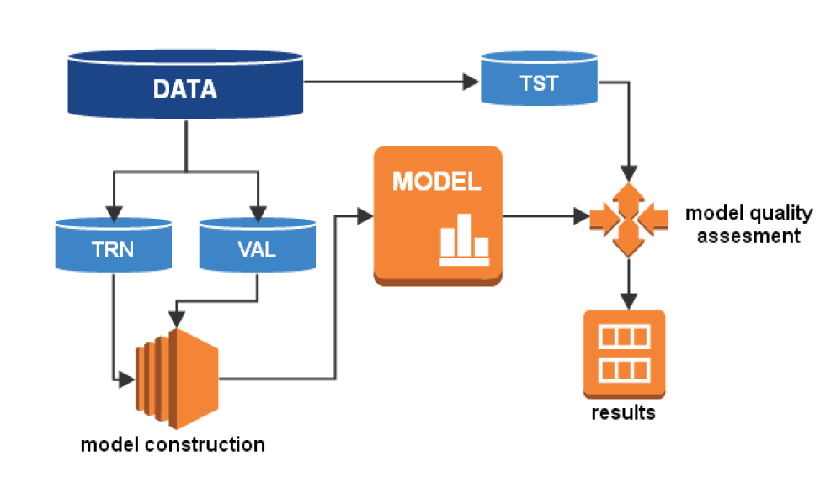
Data Partition and Preparation

Slide 16
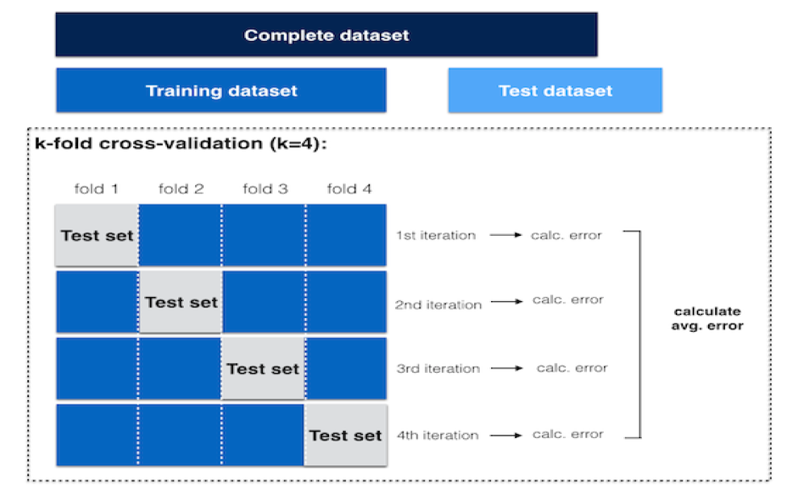
Cross Validation

Slide 17
Technical Approach – ML Techniques
Accuracy / Recall / Precision / F1 score
Hyper parameter Tuning
Evaluation with different classifiers, model parameters were varied using Grid Search , Random search , Bayesian optimization to find the best parameters
Logistic Regression
Random Forest
Decision Tree
Gaussian Naïve Bayes
XGBoost
Gradient Boosting
LightGBM
Neural Network

Slide 18
Project Scope
Data Preparation
Exploratory Data Analysis
Feature Engineering
Classifier Models: Training, Prediction and Comparison
Class Prediction
Evaluation Metrics (Classification Report - Precision , Recall, etc )

Slide 19
Technical Approach – System Design
Users Interface ( Web Browser )
Technologies : HTML , JavaScript , JQuery
Flask Server
( Python )
Feature Engineering
Technologies : Python , Pandas, numpy,sklearn ,matplotlip
Request to Server
URL route module
Trained model to prediction
Off line Model training process and model will update quarterly
( Because data will change after certain time so we
Need to retrain our model with current availability data
Exploratory Data Analysis
Feature Engineering
Classifier Models: Training, Prediction
and Comparison
Class prediction Evaluation Metrics (Classification Report - Precision , Recall, etc )
Find Best Model to Deploy in Production

Slide 20
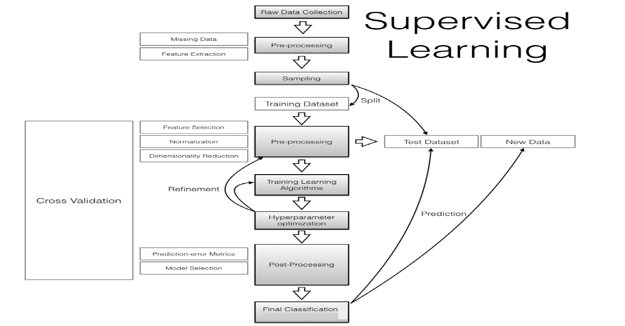
Supervised Learning Approach

Slide 21
Status Update
Data Preparation
Evaluation Metrics (Classification Report - Precision , Recall, etc )
Exploratory Data Analysis
Class Prediction
Feature Engineering
Classifier Models: Training, Prediction and Comparison
Legend:
Completed
In progress

Slide 22
Value add to this project
Performed data wrangling / cleaning, setting up the data for analysis and model building.
Dealt with data having anomalies.
Added Interaction variables.
Performed hyper parameters optimization.
Incorporated Domain Feature engineering.
Performed Exploratory Data Analysis.
Discovered patterns in data.
Built bagging based ensemble model.

Slide 23
Q&A
Thank you for your attention.

Slide 24
References
Home Credit Default Risk Competition (2018). Kaggle. https://www.kaggle.com/c/home-creditdefault-risk/overview
Bagherpour, A. (2017). Predicting mortgage loan default with machine learning methods. University of California/Riverside.
Khandani, A. E., Kim, A. J., & Lo, A. W. (2010). Consumer credit-risk models via machinelearning algorithms. Journal of Banking & Finance, 34(11), 2767-2787.
Ma, X., Sha, J., Wang, D., Yu, Y., Yang, Q., & Niu, X. (2018). Study on a prediction of P2P network loan default based on the machine learning LightGBM and XGboost algorithms according to different high dimensional data cleaning. Electronic Commerce Research and Applications, 31, 24-39.
He, H., & Ma, Y. (Eds.). (2013). Imbalanced learning: foundations, algorithms, and applications. John Wiley & Sons
Lipton, Z. C., Elkan, C., & Naryanaswamy, B. (2014, September). Optimal thresholding of classifiers to maximize F1 measure. In Joint European Conference on Machine Learning and Knowledge Discovery in Databases (pp. 225-239). Springer, Berlin, Heidelberg.
Kluyver, T., Ragan-Kelley, B., Pérez, F., Granger, B. E., Bussonnier, M., Frederic, J., ... & Ivanov, P. (2016, May). Jupyter Notebooks-a publishing format for reproducible computational workflows. In ELPUB (pp. 87-90).
Chen, T., & Guestrin, C. (2016, August). XGBoost: A scalable tree boosting system. In Proceedings of the 22nd ACM SIGKDD international conference on knowledge discovery and data mining (pp. 785-794).
Ke, G., Meng, Q., Finley, T., Wang, T., Chen, W., Ma, W., ... & Liu, T. Y. (2017). Lightgbm: A highly efficient gradient boosting decision tree. In Advances in neural information processing systems (pp. 3146-3154).
Poulos, J., & Valle, R. (2018). Missing data imputation for supervised learning. Applied Artificial Intelligence, 32(2), 186-196.
Kanter, J. M., & Veeramachaneni, K. (2015, October). Deep feature synthesis: Towards automating data science endeavors. In 2015 IEEE international conference on data science and advanced analytics (DSAA) (pp. 1-10). IEEE.
Bellman, R. (1966). Dynamic programming. Science, 153(3731), 34–37.
Wright, R. E. (1995). Logistic regression.
Pedregosa, F., Varoquaux, G., Gramfort, A., Michel, V., Thirion, B., Grisel, O., ... & Vanderplas, J. (2011). Scikit-learn: Machine learning in Python. the Journal of machine Learning research, 12, 2825-2830.
Liaw, A., & Wiener, M. (2002). Classification and regression by random forest. R news, 2(3), 18-22.
Quinlan, J. R. (2014). C4. 5: programs for machine learning. Elsevier.
Zhang H. (2004). The optimality of Naive Bayes. Proc. FLAIRS.
Ridgeway, G. (2007). Generalized Boosted Models: A guide to the gbm package. Update, 1(1),2007.
Hastie, T., Tibshirani, R., & Friedman, J. (2009). The elements of statistical learning: data mining, inference, and prediction. Springer Science & Business Media.
Bergstra, J., Yamins, D., & Cox, D. (2013, February). Making a science of model search: Hyperparameter optimization in hundreds of dimensions for vision architectures. In International conference on machine learning (pp. 115-123).
A Gentle Introduction. (2018). Kaggle. https://www.kaggle.com/willkoehrsen/start-here-a-gentleintroduction
Introduction to Automated Feature Engineering. (2018). Kaggle. https://www.kaggle.com/willkoehrsen/automated-feature-engineering-basics

